Slide 1
MEDEASE APP USING ANDROID

Slide 2
INDEX
    Abstract
    Objective of project
    Problem Statement
    Scope And Motivation
    Introduction
    Literature survey
    Existing Method
    Disadvantages
    Proposed method
    Advantages
    Project Flow
    Hardware and Software Requirements
    Modules
    UML Diagram
    Conclusion
    Future Work
    References

Slide 3
ABSTRACT
The MEDEASE is a comprehensive Android application designed to streamline healthcare services by bridging the gap between users, doctors, and medical shops. The app aims to provide an efficient, user-friendly platform that integrates appointment management, medicine search, and healthcare accessibility, ensuring seamless interaction among its stakeholders. The app includes four user roles: Admin, Doctor, Medical Shops, and User. The Admin is responsible for managing the platform by adding and updating doctors and medical shops. Doctors can log in to the app to view and manage appointments by accepting or rejecting requests. Medical Shops are enabled to log in and provide users with access to a robust search functionality for medicines. Users, as patients or customers, can register, log in, view a directory of doctors, schedule appointments, and locate nearby medical shops. MEDEASE enhances healthcare accessibility by providing a centralized platform for managing critical health-related activities. It eliminates common inefficiencies, such as long queues and limited communication, by leveraging real-time functionalities and a responsive user interface. This app ensures convenience, reliability, and a better healthcare experience for all its users.
KEYWORDS: Mobile application, Android.

Slide 4
    OBJECTIVE OF PROJECT
The primary objective is to develop an Android-based application that simplifies healthcare access and management. The app facilitates appointment scheduling, doctor management, and medicine search for users. It empowers doctors to handle appointments effectively and provides medical shops with a platform to showcase medicine availability. MEDEASE ensures real-time interaction, convenience, and efficiency for all users. It aims to revolutionize healthcare accessibility through a centralized platform.

Slide 5
    PROBLEM STATEMENT
The manual healthcare system is fraught with inefficiencies, such as unstructured appointment processes, limited communication between patients and doctors, and difficulty in accessing medicines. These issues result in delays, frustration, and reduced quality of care. The absence of a unified platform makes healthcare access cumbersome and time-consuming. A digital solution is needed to address these problems effectively. MEDEASE aims to resolve these challenges by integrating healthcare services into one app.

Slide 6
    SCOPE
MEDEASE targets users, doctors, and medical shops, providing tailored functionalities for each. It allows users to book appointments, view doctor details, and locate nearby medical shops. Doctors can manage their appointments with real-time updates, and medical shops can assist users with medicine searches. The app’s admin feature ensures smooth operation by managing data related to doctors and shops. MEDEASE is scalable to incorporate additional healthcare functionalities in the future.

Slide 7
    MOTIVATION
The growing challenges in accessing timely healthcare services and managing appointments inspired the development of a centralized solution. Patients often face long waits, difficulty in locating medical shops, and limited communication with healthcare providers. MEDEASE aims to bridge these gaps by leveraging technology. The app enhances user convenience while reducing the inefficiencies of the manual healthcare system. It provides a streamlined approach to healthcare for all stakeholders. .

Slide 8
    INTRODUCTION
In the modern world, access to healthcare services is crucial, yet often hindered by inefficiencies in traditional systems. Long waiting times, difficulties in finding the right doctors, and limited accessibility to medical shops make healthcare challenging for many. These issues highlight the need for a technology-driven solution that simplifies and streamlines healthcare management. MEDEASE is an Android-based application designed to address these challenges by creating a centralized platform that connects patients, doctors, and medical shops. The app provides a user-friendly interface where users can register, log in, and conveniently book appointments with doctors. Additionally, they can locate nearby medical shops and search for medicines in real-time.

Slide 9
    INTRODUCTION
This functionality reduces delays and improves access to essential healthcare services. Doctors benefit from MEDEASE through an efficient appointment management system, allowing them to view, accept, or reject appointment requests directly through the app. This reduces administrative burdens and enhances the patient experience. Medical shops can use the platform to list and update medicine availability, making it easier for users to find required medicines without hassle. The admin feature ensures smooth system operations by enabling administrators to add and manage doctor and medical shop profiles. This centralized control helps maintain the platform’s reliability and efficiency. MEDEASE aims to revolutionize healthcare by integrating technology into everyday health management. The app eliminates inefficiencies of the manual system, enhances communication between stakeholders, and ensures timely access to healthcare resources. With its scalable architecture, MEDEASE is well-positioned to incorporate additional features and expand its scope, ultimately contributing to better healthcare outcomes.

Slide 10
    LITERATURE SURVEY
S.No | Name | Title | Outcome
1 | Anushka Goel and Udita Taneja (2023) | The transformative potential of mHealth applications in healthcare delivery | Explores trends, challenges, and opportunities of mHealth; highlights real-time access enhancing patient outcomes.
2 | Yazeed Yasin Ghadi et al. (2024) | Integration of 5G and mobile edge computing in mHealth applications | Discusses secure, scalable, and efficient mHealth systems with advancements in 5G and edge computing.
3 | El-Sherif and Mohamed Abouzid (2022) | Global impact of mHealth applications on public health | Maps mHealth technologies' effectiveness in addressing global health challenges and universal applicability.
4 | Balla Rama Devi et al. (2015) | Use of mHealth applications in long-term management of HIV/AIDS and tuberculosis | Highlights the role of mHealth in chronic disease management through continuous patient support and monitoring.
5 | Shaojing Fan et al. (2023) | Factors influencing user willingness to adopt mHealth applications | Identifies barriers and motivators for mHealth adoption, offering insights for developers and policymakers.

Slide 11
    Modules
Admin Module: The Admin module oversees system operations, allowing administrators to add, update, and manage doctors and medical shops to ensure a well-maintained platform.
Doctor Module: The Doctor module enables healthcare providers to log in, view patient appointments, and manage them by accepting or rejecting requests, ensuring efficient scheduling.
User Module: the User module is designed for patients to register, log in, view doctor profiles, schedule appointments, and locate nearby medical shops.
Hospital Module: The Doctor module enables healthcare providers to log in, view patient appointments, and manage them by accepting or rejecting requests, ensuring efficient scheduling.
Medical shops module: The Medical Shops module provides functionality for shop owners to log in and list available medicines, allowing users to search for required medicines in real time.

Slide 12
Existing method:
The manual healthcare system faces significant inefficiencies, such as long waiting times for appointments due to lack of real-time scheduling and communication between patients and doctors. Patients often struggle to find nearby medical shops or check medicine availability, leading to delays in treatment. Additionally, managing records manually increases the risk of errors and administrative burdens, further complicating healthcare delivery.

Slide 13
Disadvantages in Existing method:
Lack of real-time scheduling leads to long waiting times and communication gaps between patients and doctors.
Difficulty in finding nearby medical shops or checking medicine availability delays treatment.
Manual management of records increases the likelihood of errors and administrative inefficiencies.

Slide 14
Proposed method:
The MEDEASE app is a centralized Android-based platform designed to enhance healthcare accessibility by integrating users, doctors, and medical shops. It allows users to register, log in, book doctor appointments, and locate medical shops. Doctors can manage appointments efficiently by accepting or rejecting them, while medical shops offer a searchable database for medicines. Admins oversee the system by adding and managing doctors and medical shops. The proposed system ensures convenience, real-time updates, and improved communication in healthcare services.

Slide 15
Advantages of Proposed method:
Provides users with easy access to doctors and medical shops, streamlining healthcare services on a single platform.
Enables doctors to manage appointments in real time, improving patient flow and reducing waiting times.
Allows users to quickly search for medicines in nearby medical shops, saving time and effort.
Simplifies healthcare interactions through an intuitive and responsive app design for all stakeholders.
Offers admin tools to manage doctors and medical shops effectively, ensuring a well-maintained system.

Slide 16
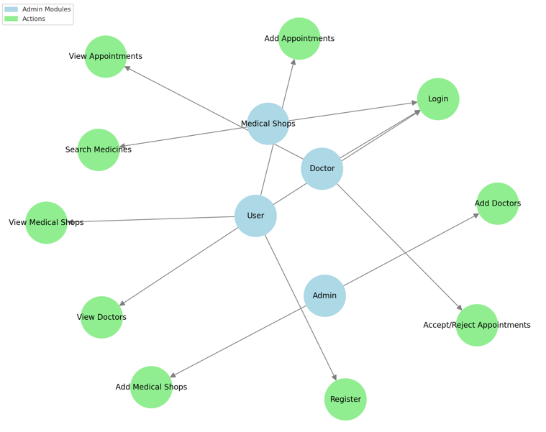
PROJECT FLLOW
Figure: work Flow of Proposed system

Slide 17
HARDWARE & SOFTWARE REQUIREMENTS
SOFTWARE REQUIREMENS
Operating System - Windows 10
JDK - Java(kotlin)
SDK - Android
IDE - Android studio
Database - my SQL

Slide 18
HARDWARE REQUIREMENTS
Processor - I3/Intel Processor
RAM - 8 GB
Hard Disk - 1TB

Slide 19
    UML DIAGRAMS
Use Case Diagram:
A use case diagram in the Unified Modeling Language (UML) is a type of behavioral diagram defined by and created from a Use-case analysis. Its purpose is to present a graphical overview of the functionality provided by a system in terms of actors, their goals (represented as use cases), and any dependencies between those use cases. The main purpose of a use case diagram is to show what system functions are performed for which actor. Roles of the actors in the system can be depicted.

Slide 20
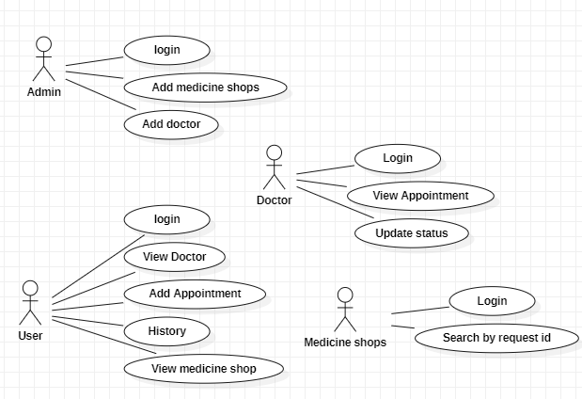
    UML DIAGRAMS
Figure: Use Case Diagram

Slide 21
    UML DIAGRAMS
Class Diagram:
In software engineering, a class diagram in the Unified Modelling Language (UML) is a type of static structure diagram that describes the structure of a system by showing the system's classes, their attributes, operations (or methods), and the relationships among the classes. It explains which class contains information.

Slide 22
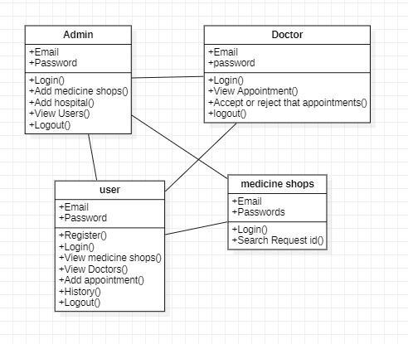
    UML DIAGRAMS
Figure: Class diagram

Slide 23
    UML DIAGRAMS
Sequence Diagram:
A sequence diagram in Unified Modelling Language (UML) is a kind of interaction diagram that shows how processes operate with one another and in what order. It is a construct of a Message Sequence Chart. Sequence diagrams are sometimes called event diagrams, event scenarios, and timing diagrams.

Slide 24
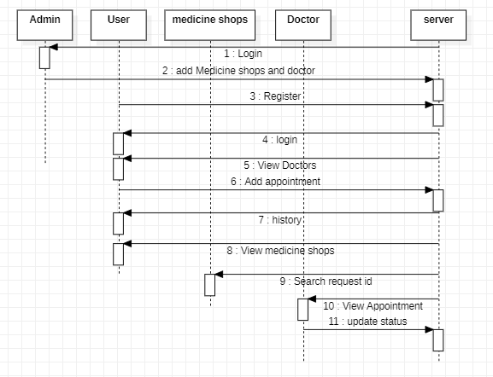
    UML DIAGRAMS
Figure: Sequence diagram

Slide 25
    UML DIAGRAMS
Collaboration Diagram:
In collaboration diagram the method call sequence is indicated by some numbering technique as shown below. The number indicates how the methods are called one after another. We have taken the same order management system to describe the collaboration diagram. The method calls are similar to that of a sequence diagram. But the difference is that the sequence diagram does not describe the object organization whereas the collaboration diagram shows the object organization.

Slide 26
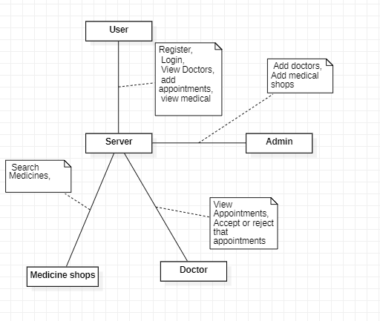
    UML DIAGRAMS
Figure: Collaboration diagram

Slide 27
    UML DIAGRAMS
Deployment Diagram
Deployment diagram represents the deployment view of a system. It is related to the component diagram. Because the components are deployed using the deployment diagrams. A deployment diagram consists of nodes. Nodes are nothing but physical hardware’s used to deploy the application.

Slide 28
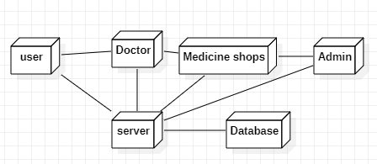
    UML DIAGRAMS
Figure: Deployment diagram

Slide 29
    UML DIAGRAMS
Activity Diagram:
Activity diagrams are graphical representations of workflows of stepwise activities and actions with support for choice, iteration and concurrency. In the Unified Modelling Language, activity diagrams can be used to describe the business and operational step-by-step workflows of components in a system. An activity diagram shows the overall flow of control.

Slide 30
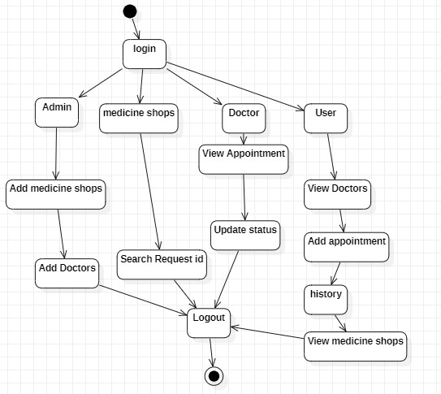
    UML DIAGRAMS
Figure: Activity diagram

Slide 31
    UML DIAGRAMS
Component Diagram:
A component diagram, also known as a UML component diagram, describes the organization and wiring of the physical components in a system. Component diagrams are often drawn to help model implementation details and double-check that every aspect of the system's required functions is covered by planned development.

Slide 32
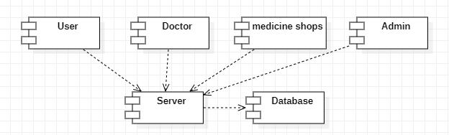
    UML DIAGRAMS
Figure: Component diagram

Slide 33
    UML DIAGRAMS
ER Diagram:
An Entity–relationship model (ER model) describes the structure of a database with the help of a diagram, which is known as Entity Relationship Diagram (ER Diagram). An ER model is a design or blueprint of a database that can later be implemented as a database. The main components of E-R model are: entity set and relationship set.
An ER diagram shows the relationship among entity sets. An entity set is a group of similar entities and these entities can have attributes. In terms of DBMS, an entity is a table or attribute of a table in database, so by showing relationship among tables and their attributes, ER diagram shows the complete logical structure of a database. Let’s have a look at a simple ER diagram to understand this concept.

Slide 34
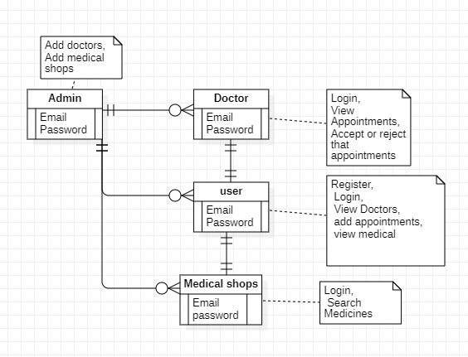
    UML DIAGRAMS
Figure: ER diagram

Slide 35
    UML DIAGRAMS
DFD Diagram:
A Data Flow Diagram (DFD) is a traditional way to visualize the information flows within a system. A neat and clear DFD can depict a good amount of the system requirements graphically. It can be manual, automated, or a combination of both. It shows how information enters and leaves the system, what changes the information and where information is stored. The purpose of a DFD is to show the scope and boundaries of a system as a whole. It may be used as a communications tool between a systems analyst and any person who plays a part in the system that acts as the starting point for redesigning a system.

Slide 36
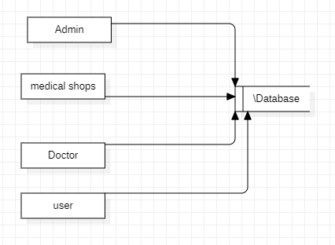
    UML DIAGRAMS
Figure: DFD diagram

Slide 37
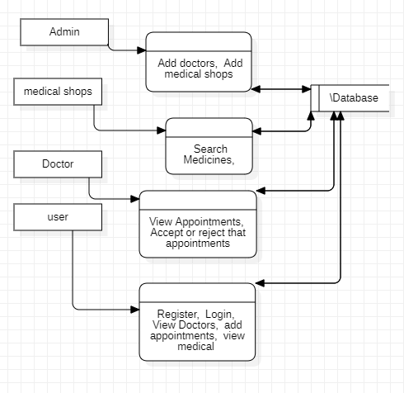
    UML DIAGRAMS
Figure: DFD diagram

Slide 38
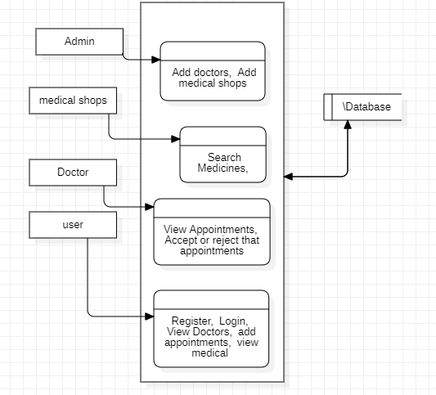
    UML DIAGRAMS
Figure: DFD diagram

Slide 39
    CONCLUSION
The MEDEASE provides a streamlined solution to overcome the inefficiencies of traditional healthcare systems. By integrating users, doctors, and medical shops into a single Android-based platform, the app enhances accessibility, convenience, and efficiency in healthcare services. With its user-friendly interface and real-time functionalities, MEDEASE empowers users to book appointments, find nearby medical shops, and search for medicines. Doctors and medical shops benefit from efficient appointment and inventory management, ensuring a better overall experience for all stakeholders. The system reduces manual errors, saves time, and improves healthcare outcomes, making it a valuable tool for modern healthcare delivery.

Slide 40
    FUTURE ENHANCEMENT:
The future scope of this application involves incorporating additional Looking ahead, MEDEASE has immense potential for future enhancements. Features such as teleconsultations, electronic health records (EHR), and AI-driven health recommendations can be integrated to expand the app's functionality. Additionally, incorporating multilingual support and location-based emergency services can make the platform more inclusive and beneficial. Partnerships with pharmacies for medicine delivery and with diagnostic labs for test bookings can further enhance the app’s utility. These enhancements will ensure that MEDEASE continues to adapt to evolving healthcare needs and remains a comprehensive solution for modern healthcare challenges.

Slide 41
REFERENCES
Anushka Goel & Udita Taneja (2023). Mobile health applications for health-care delivery: trends, opportunities, and challenges. Journal of Public Health.
Yazeed Yasin Ghadi, Syed Faisal Abbas Shah, Tehseen Mazhar, Tariq Shahzad, Khmaies Ouahada, & Habib Hamam (2024). Enhancing patient healthcare with mobile edge computing and 5G: challenges and solutions for secure online health tools. Journal of Cloud Computing.
El-Sherif & Mohamed Abouzid (2022). Analysis of mHealth research: mapping the relationship between mobile health applications and global health. Globalization and Health.
Balla Rama Devi, Shabbir Syed-Abdul, Arun Kumar, Usman Iqbal, Phung-Anh Nguyen (2015). mHealth: An updated systematic review with a focus on HIV/AIDS and tuberculosis long term management using mobile phones. Computer Methods and Programs in Biomedicine.
Shaojing Fan, Ramesh C. Jain, Mohan S. Kankanhalli (2023). A Comprehensive Picture of Factors Affecting User Willingness to Use Mobile Health Applications. arXiv preprint.

Slide 42
REFERENCES
Anindya Ghose, Xitong Guo, Beibei Li, Yuanyuan Dang (2021). Empowering Patients Using Smart Mobile Health Platforms: Evidence From A Randomized Field Experiment. arXiv preprint.
Bakheet Aljedaani, Aakash Ahmad, Mansooreh Zahedi, M. Ali Babar (2022). An Empirical Study on Secure Usage of Mobile Health Apps: The Attack Simulation Approach. arXiv preprint.
Ismail Ali Afrah, Utku Kose (2021). MHealth: An Artificial Intelligence Oriented Mobile Application for Personal Healthcare Support. arXiv preprint.
Ralph Maddison, Anna Rolleston, Ralph Stewart, Yannan Jiang, Robyn Whittaker (2015). Text Message and Internet Support for Coronary Heart Disease Self-Management: Results From the Text4Heart Randomized Controlled Trial. Journal of Medical Internet Research.
Taridzo Chomutare, Luis Fernandez-Luque, Eirik Årsand, Gunnar Hartvigsen (2011). Features of Mobile Diabetes Applications: Review of the Literature and Analysis of Current Applications Compared Against Evidence-Based Guidelines. Journal of Medical Internet Research.

